Slide 1
CS-23-313
Elementary School Computer Science Engagement
Jared Dawson
Kiersten Kofi AdomFrimpong
Brianna Barrett
Mason Delane

Slide 2
Objective/Problem Statement
Objective : Build a website that stores engaging activities in the domain of Computer Science in which teachers can easily access to teach there classes’ lessons following SOL with limited knowledge on the subject matter itself.
Student Ages : Elementary and Middle School
What is SOL: Standards of Learning (SOL) assessments are the main part of the Virginia Assessment Program for grades 3-12. SOL tests are used to fulfill: Federal requirements for annual testing in reading, mathematics, and science. State requirements for testing in writing and social studies.
Why : Alleviate the fear that most teacher feel when faced with Computer Science topics. Make computer science teachable in early education instead of only present in higher grade levels.

Slide 3
Project Timeline
Phase 1 (First Semester)
Finalize Website utilizing HTML, CSS that will store lessons
Organize Research
Established system inside drive to store research utilizing excel
Create a Storyboard
Work on Documentation
Research
Create worksheets for kids
Create direction for teacher following SOL
Make actual exercises themselves and have step by step direction for teachers who will be teaching them
Phase 2 (Second Semester)
Go to schools around Richmond and implement exercises

Slide 4

Research Process
Go into google excel sheet and fill out the activity currently researching
Create a lesson plan document following the SOL
Create a worksheet for students
Create a answer key for teacher with links for completed activity itself
Create step by step non technical instructions for teacher to follow to teach the lesson
Once proper documents are created that are necessary for each lesson change status in sheets

Slide 5
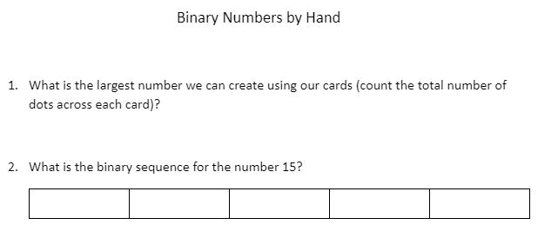
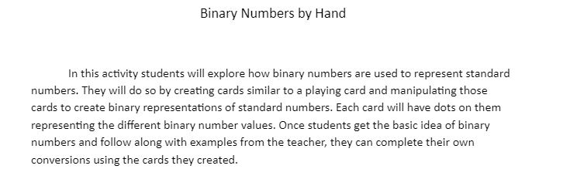
Lesson Plans / Worksheets
Each tab in the website will have pairings of lesson plans and worksheets
Lesson plans are used as an introduction to each topic and identify key learning points
These key learning points correspond to the Virginia SOL’s
Teachers will give the lesson plan then provide worksheets/activities to the students

Slide 6
Revision Process
Once an activity is created it goes through a series of revisions before being added to the website
Having people with no technical background complete activities to ensure simplicity
Group members complete activities and provide feedback
Edits are made
Once all revisions are completed it is added to the website

Slide 7




Process of Web Development
Test
Deploy
Launch
Content Writing & Assembly
Design & Code
Sharing Documentation & Accessibility
Maintenance

Slide 8
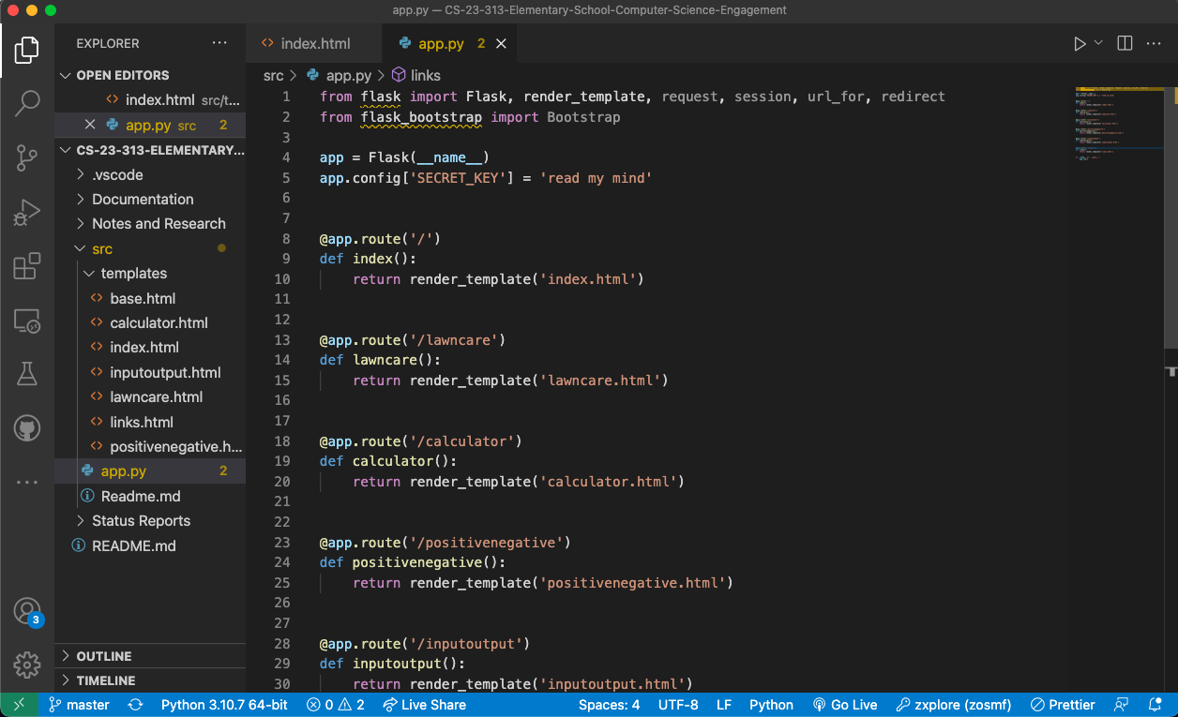

Slide 9
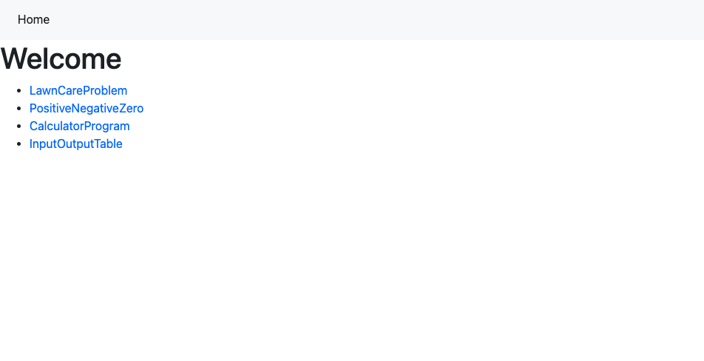
Current Iteration

Slide 10

Home
Welcome
Interactive Computer Science Activities
Lawn Care Problem
Coming Soon
Coming Soon
Positive Negative Zero
Coming Soon
Coming Soon
Calculator Program
Coming Soon
Coming Soon
Input Output Table
Coming Soon
Coming Soon

